Slide 1





A smart grid of plastics – Technical conditions for the sorting and pre-step evaluation for a “factory of the future”
Project progress
Anamaria Barrera Bogoya
Tutors:
Hakim Boudaoud
Fabio A. Cruz S.
Cécile Nouvel
Sina Leipold
Paulo César Narváez Rincón
06/05/2019

Slide 2

Content
Project context
Objectives
3D Printing Open-source
Additive Manufacturing
Plastics in 3D printing
Plastic recycling Pre-step
Methods of plastic recycling
Mechanical recycling steps in centralized circuit
Circular Economy
Context: Statistics of wastes management
Case of study: Nancy
Planning
Next steps
References

Slide 3

Project context
Geographical distributed space where the polymer recycling process of the surrounding areas will be carried out.
Objective: Plastic recycling by 3D Printing in short circuit.
Development of a circular economy circuit with the feedstock of 3D Printers.
Benefits:
Avoid the use of the environment as a sink for residuals
Minimize the use of virgin materials

Slide 4
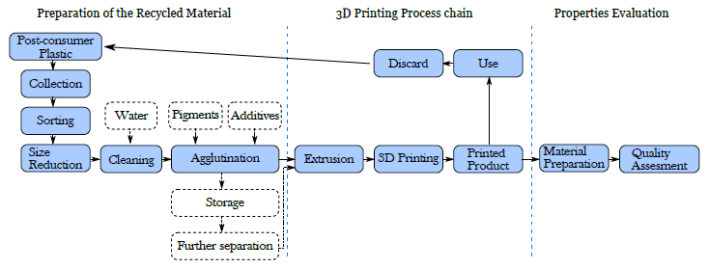
Project context
Pavlo, S., Fabio, C., Hakim, B., & Mauricio, C. (2018). 3D-Printing Based Distributed Plastic Recycling: A Conceptual Model for Closed-Loop Supply Chain Design. In 2018 IEEE International Conference on Engineering, Technology and Innovation (ICE/ITMC) (pp. 1–8). IEEE.
Cruz Sanchez, F. A., Boudaoud, H., Hoppe, S., & Camargo, M. (2017). Polymer recycling in an open-source additive manufacturing context: Mechanical issues. Additive Manufacturing, 17, 87–105.
Anamaria

Slide 5
Objectives
How to generate a local circuit of plastic recycling for 3D Printing in Nancy?
3D Printing Open-source
Circular Economy – Local Circuit
Plastic Recycling Pre-step
Anamaria

Slide 6
OBJECTIVES
1. 3D Printing Open – Source | 2. Plastic Recycling Pre - step | 3. Circular Economy – Local Circuit
Bibliographic research: 1.1. Additive manufacturing 1.2. Plastics used in 3D Printing | Bibliographic research: 2.1. Scientific: Methods of plastic recycling 2.2. Technique: Mechanical recycling steps in centralized circuit | Bibliographic research: 3.1. Context: Deposit of plastic wastes in Europe, France and Nancy 3.2. How to make a local circuit emerge? Business sector Public sector Citizen sector 3.3. Indicators and tools for economical, environmental and social evaluation.

Slide 7
OBJECTIVES
1. 3D Printing Open – Source | 2. Plastic Recycling Pre - step | 3. Circular Economy – Local Circuit
Bibliographic research: 1.1. Additive manufacturing 1.2. Plastics used in 3D Printing | Bibliographic research: 2.1. Scientific: Methods of plastic recycling 2.2. Technique: Mechanical recycling steps in centralized circuit | Bibliographic research: 3.1. Context: Deposit of plastic wastes in Europe, France and Nancy 3.2. How to make a local circuit emerge? Business sector Public sector Citizen sector 3.3. Indicators and tools for economical, environmental and social evaluation.

Slide 8
1.1. Additive manufacturing
Additive Manufacturing
Material Jetting
Binder Jetting
Material Extrusion
Powder Bed Fusion
Directed Energy Disposition
Sheet Lamination
Vat Photopolymerization
Figure 1. Additive Manufacturing classification. Adapted from [1 – 2]

Slide 9
1.1. Additive manufacturing
Additive Manufacturing
Material Jetting
Binder Jetting
Material Extrusion
Powder Bed Fusion
Directed Energy Disposition
Sheet Lamination
Vat Photopolymerization
Figure 1. Additive Manufacturing classification. Adapted from [1 – 2]

Slide 10
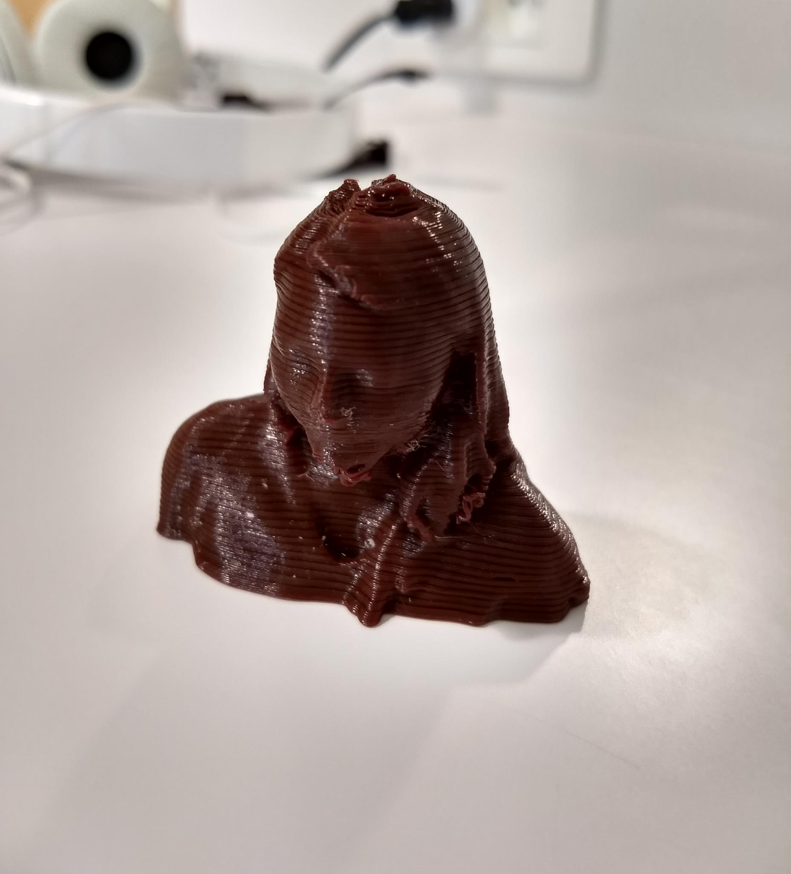
2.1. Plastics used in 3D Printing
PET: Polyethylene terephthalate
PETG: Polyethylene terephthalate glycol
HDPE: High-density polyethylene
LDPE: Low-density polyethylene
PP: Polypropylene
PS: Polystyrene
PC: Polycarbonate
ABS: Acrylonitrile butadiene styrene
PLA: Polylactic acid
PEF: Polyethylene furanoate

Slide 11
OBJECTIVES
1. 3D Printing Open – Source | 2. Plastic Recycling Pre - step | 3. Circular Economy – Local Circuit
Bibliographic research: 1.1. Additive manufacturing 1.2. Plastics used in 3D Printing | Bibliographic research: 2.1. Scientific: Methods of plastic recycling 2.2. Technique: Mechanical recycling steps in centralized circuit | Bibliographic research: 3.1. Context: Deposit of plastic wastes in Europe, France and Nancy 3.2. How to make a local circuit emerge? Business sector Public sector Citizen sector 3.3. Indicators and tools for economical, environmental and social evaluation.

Slide 12
Objectives: Plastic recycling pre – step
Systematic literature review
Scientific
Mechanical recycling steps
Technique
Operational conditions
Equipment
Plastic recycling methods

Slide 13
2.1. Methods of plastic recycling
Plastic recycling methods
[3 – 4]
Primary recycling
Physical changes to produce a new generation of products with the same purpose as the original one
Secondary recycling
(Mechanical recycling)
Physical operations applied to transform plastic waste in feedstock for another process
Tertiary recycling
(Chemical recycling)
Polymer decomposition to their constitutive monomers or other valuable low molecular weight fragments
Quaternary recycling (Energy recovery)
Combustion process performed to produce electricity and district heating
Feasible
Feasible
Not feasible: High costs, technology required.
Not feasible: No valorization of wastes.

Slide 14
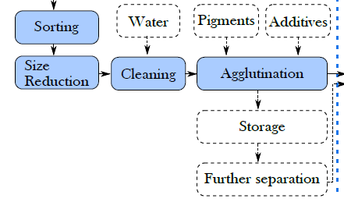
2.2. Mechanical recycling steps
Initial study of pre-step

Slide 15
2.2. Mechanical recycling steps [5]
Steps summarized as a result of literature review (40 articles studied)
Waste material
Initial sorting
Grinding
Manual sorting
Automated sorting
Washing
Second sorting
Conversion to a reusable material
Densification (films)
Extrusion compounding
Manual sorting
Automated sorting
Drying

Slide 16
2.2. Mechanical recycling steps [5]
Steps summarized as a result of literature review
Waste material
Initial sorting
Grinding
Manual sorting
Automated sorting
Washing
Second sorting
Conversion to a reusable material
Densification (films)
Extrusion compounding
Manual sorting
Automated sorting
Drying

Slide 17
2.2. Mechanical recycling steps
Automated sorting techniques [6]
Technology |  | Additional substances | Equipment | Separation principle
Direct sorting | Magnetic Density Separation | Magnetic liquid (ferrofluid) | Large magnets | Difference in density
 | Tribo-electrostatic | - | Tribo-charging chamber | Difference in electrical conductivity
 | Hydro-cyclone | Water | Cyclone | Difference in density
 | Jigging | Water | Pulsatile bed (perforated vessel) | Difference in density
 | Froth flotation | Water | Vessel with agitation and air admission | Plastic hydrophobicity
 | Air separator | Compressed air | Nozzle of compressed air | Difference in density
Indirect sorting | Laser Induced Breakdown Spectroscopy (LIBS) | - | High power laser pulse (neodymium-doped yttrium aluminum garnet laser), spectral range spectrometer and a processing unit | Characteristic atomic emission lines
 | X-ray fluorescence | - | High-intensity X-ray beam, detector | Characteristic atomic emission lines
 | Spectroscopic sorting | - | Light source, sensor and processor unit | Different interactions between plastics and light

Slide 18
2.2. Mechanical recycling steps
Waste material
Initial sorting
Grinding
Manual sorting
Automated sorting
Washing
Second sorting
Conversion to a reusable material
Densification (films)
Extrusion compounding
Manual sorting
Automated sorting
Drying
Principal devices employed:
Cutting mill Retsch SM 100, 200, 300 (Most commonly used)
Disk mill
Operational conditions not specified

Slide 19
2.2. Mechanical recycling steps
Waste material
Initial sorting
Grinding
Manual sorting
Automated sorting
Washing
Second sorting
Conversion to a reusable material
Densification (films)
Extrusion compounding
Manual sorting
Automated sorting
Drying
Substance | Max. Concentration | Max. Temperature | Max. Time
Water | - | 60 °C (PP). 24 °C | 10 min
Water – Soap | - | 85 °C | 15 min
Water – NaOH | 1% p/p | 24 °C | 5 min
Water – NaClO | 9% v/v | - | 30 min

Slide 20
2.2. Mechanical recycling steps
Waste material
Initial sorting
Grinding
Manual sorting
Automated sorting
Washing
Second sorting
Conversion to a reusable material
Densification (films)
Extrusion compounding
Manual sorting
Automated sorting
Drying
Technology | Max. Temperature | Max. Time
Dehumidifier | 120 °C | 48 h
Oven | 100 °C | 24 h
Oven with vacuum | 85 °C | 2 h
Natural | Room temperature | 48 h
Centrifuge | - | -
Fluidized bed hot air | - | -

Slide 21
2.2. Mechanical recycling steps
Waste material
Initial sorting
Grinding
Manual sorting
Automated sorting
Washing
Second sorting
Conversion to a reusable material
Densification (films)
Extrusion compounding
Manual sorting
Automated sorting
Drying
Grinding, washing and drying steps are not difficult to implement in a local distributed way
Sorting is the most complex step
Economical and social evaluation in terms of Circular Economy

Slide 22
OBJECTIVES
1. 3D Printing Open – Source | 2. Plastic Recycling Pre - step | 3. Circular Economy – Local Circuit
Bibliographic research: 1.1. Additive manufacturing 1.2. Plastics used in 3D Printing | Bibliographic research: 2.1. Scientific: Methods of plastic recycling 2.2. Technique: Mechanical recycling steps in centralized circuit | Bibliographic research: 3.1. Context: Deposit of plastic wastes in Europe, France and Nancy 3.2. How to make a local circuit emerge? Business sector Public sector Citizen sector 3.3. Indicators and tools for economical, environmental and social evaluation.

Slide 23
Intersection of objectives 1 and 2
PET: Polyethylene terephthalate
PETG: Polyethylene terephthalate glycol
HDPE: High-density polyethylene
LDPE: Low-density polyethylene
PP: Polypropylene
PS: Polystyrene
PC: Polycarbonate
ABS: Acrylonitrile butadiene styrene
PVC: Polyvinyl chloride
PLA: Polylactic acid
PEF: Polyethylene furanoate
Plastics
commonly
recycled
Plastics
3D Printing
PVC
PET
HDPE PETG
LDPE
PP PLA
PS PEF
PC
ABS

Slide 24
OBJECTIVES
1. 3D Printing Open – Source | 2. Plastic Recycling Pre - step | 3. Circular Economy – Local Circuit
Bibliographic research: 1.1. Additive manufacturing 1.2. Plastics used in 3D Printing | Bibliographic research: 2.1. Scientific: Methods of plastic recycling 2.2. Technique: Mechanical recycling steps in centralized circuit | Bibliographic research: 3.1. Context: Deposit of plastic wastes in Europe, France and Nancy 3.2. How to make a local circuit emerge? Business sector Public sector Citizen sector 3.3. Indicators and tools for economical, environmental and social evaluation.

Slide 25
OBJECTIVES: Circular economy – Local circuit
Context: Statistics of generated, treated and recycled plastic wastes in Europe, France and Nancy
Information required:
Indicators for process evaluation
Tools for the implementation of local circuit
Case of study: Nancy
How to make a local circuit emerge?
Economical and social point of view
Business sector
Public sector
Citizen sector

Slide 26
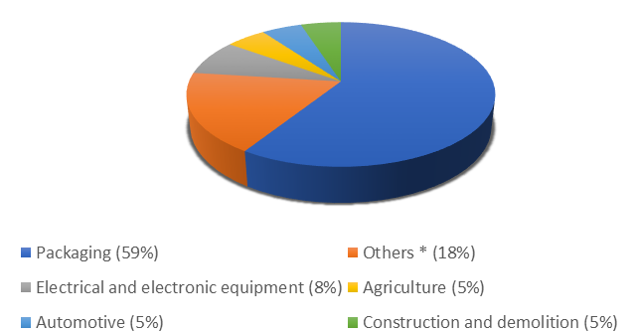
3.1. Context: Deposit of plastic wastes
Deposit of plastic wastes in Europe
Figure 2. Plastic waste generation in Europe in 2015. [7]
* Consumer and household appliances, furniture, sport, health and safety
Figure 3. Plastic resins content in European waste streams in 2012. [8]

Slide 27
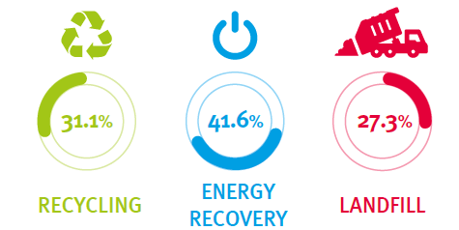
3.1. Context: Deposit of plastic wastes
Deposit of plastic wastes in Europe
Figure 4. Plastic waste treatment in 2016. [9]

Slide 28
3.1. Context: Deposit of plastic wastes
Deposit of plastic wastes in France
Figure 5. Plastic wastes in France in 2016. [10]
Figure 6. Plastic flows in France in 2012. [11]

Slide 29
3.1. Context: Deposit of plastic wastes
Deposit of plastic wastes in Nancy
Figure 7. Collected tonnes in Nancy in 2017. [12]
Figure 8. Recycled tonnes in Nancy in 2017. [12]

Slide 30

3.2. Case of study: Nancy
Design of the pre-step process
Implementation of quality and sustainability indicators
Foire Expo Internationale:
Plastic collection point
Surveys to identify intention and behavior towards recycling in the assistants.

Slide 31
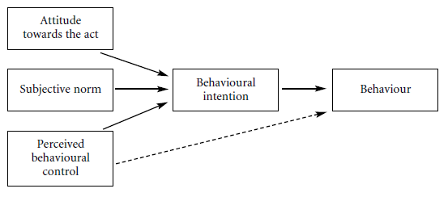
3.2. Case of study: Nancy - surveys
Theories studied in study of behavior towards recycling
Theory of Planned Behavior (TPB)
Theory of Reasoned Action (TRA)
Model of altruistic behavior
Figure 9. Schema of the TPB [13].

Slide 32
3.2. Case of study: Nancy - surveys
Measures
Gender and social-economic situation
Attitudes
Subjective norm
Perceived behavioral control
Recycling intention
Recycling behavior
Each item will be measured by one question with a multiscale response model, evaluating the influence of:
Publicity
An incentive
The availability of recycling facilities
The fact of knowing the final result of recycling procedure

Slide 33
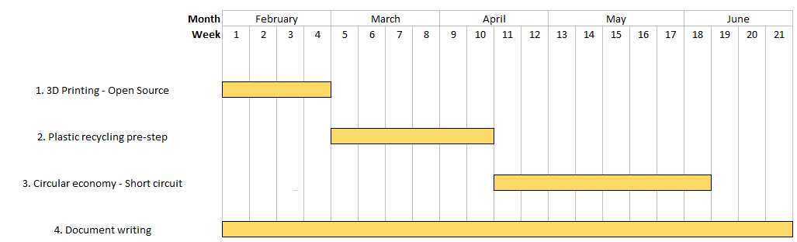
planning

Slide 34
Next steps
1. 3D Printing Open – Source | 2. Plastic Recycling Pre - step | 3. Circular Economy – Local Circuit
Bibliographic research: 1.1. Additive manufacturing 1.2. Plastics used in 3D Printing | Bibliographic research: 2.1. Scientific: Methods of plastic recycling 2.2. Technique: Mechanical recycling steps in centralized circuit | Bibliographic research: 3.1. Context: Deposit of plastic wastes in Europe, France and Nancy 3.2. How to make a local circuit emerge? Business sector Public sector Citizen sector 3.3. Indicators and tools for economical, environmental and social evaluation.

Slide 35
References
[1] S. C. Ligon et al., “Polymers for 3D Printing and Customized Additive Manufacturing,” 2017.
[2] Hybrid Manufacturing Technologies, “7 Families of Additive Manufacturing.” [Online]. Available: http://www.hybridmanutech.com/resources.html#.
[3] M. Okan, H. M. Aydin, and M. Barsbay, “Current approaches to waste polymer utilization and minimization : a review Meltem Okan , a Halil Murat Aydin b and Murat Barsbay c * STATE AND CONVENTIONAL METHODS OF,” no. May, 2018.
[4] K. Ragaert, L. Delva, and K. Van Geem, “Mechanical and chemical recycling of solid plastic waste,” Waste Manag., vol. 69, pp. 24–58, 2017.
[5] K. Makenji, “Mechanical methods for recycling waste composites,” Manag. Recycl. Reuse Waste Compos., pp. 217–252, 2009.
[6] S. Paulraj, S. Hait, and A. Thakur, “A review on automated sorting of source-separated municipal solid waste for recycling,” Waste Manag., vol. 60, pp. 56–74, 2017.
[7] European Commission, “A European strategy for plastics in a circular economy.”
[8] M. Hestin, T. Faninger, and L. Milios, “Increased EU Plastics Recycling Targets : Environmental , Economic and Social Impact Assessment Final Report Prepared for Plastic Recyclers Europe,” 2016.
[9] Plastics Europe, “Plastics – the Facts 2018,” 2018.
[10] Eurostat, “Eurostat Database.” [Online]. Available: https://ec.europa.eu/eurostat/web/waste/data/database.
[11] Deloitte. ADEME, “Analyse de la chaîne de valeur du recyclage des plastiques en France - Synthèse,” 2014.
[12] GrandNancy, “Rapport annuel 2017,” 2017.
[13] J. Davies, G. R. Foxall, and J. Pallister, “Beyond the intention-behaviour mythology,” Mark. Theory, vol. 2, no. 1, pp. 29–113, 2002.

Slide 36
Thank you for your attention

